Slide 1
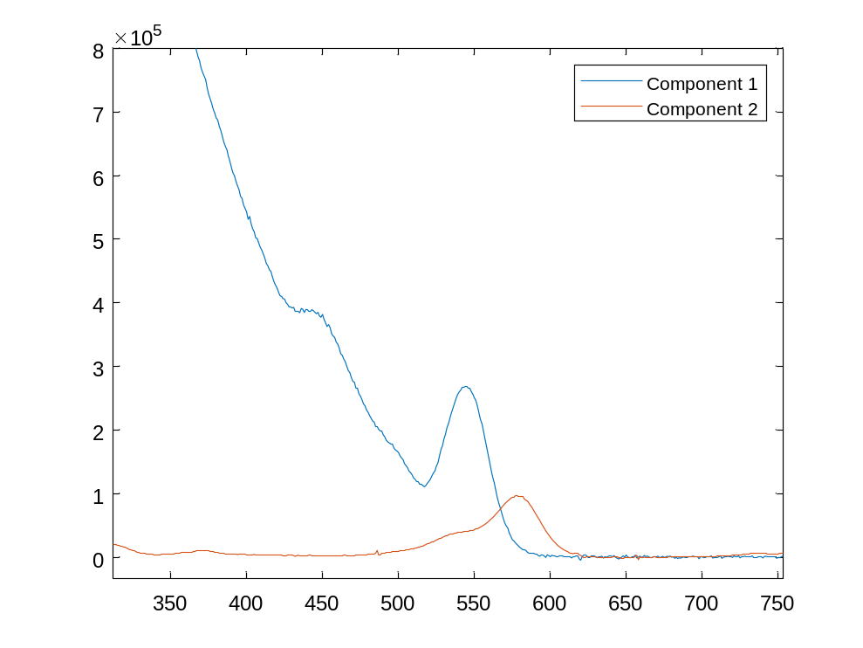
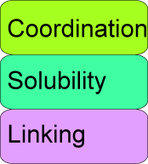
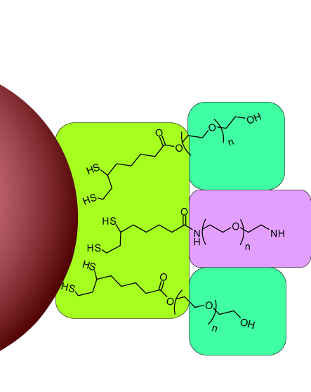
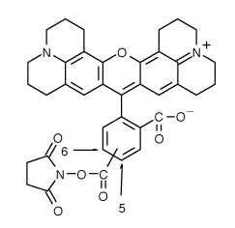
ABG 4-8 quantum dot / dye conjugate (4/4/2007): Synthesis
In this experiment:
  558 nm emis CdSe/CdZnS QDs, with PEG ligands 20% NH₂ termination
  Buffer: 0.05 M NaHCO₃
  Carboxyrhodamine (“rox”) dye NHS ester introduced in DMF (<1% of total volume)
  Allowed to react ~ 1 hr for amide bond formation, then purified to remove excess or un-bound dye.
The extinction coefficient (absorbance per molar per cm) for each separate component is known at a particular wavelength, so that you can scale a measured absorption spectrum to give the extinction spectrum of each component.
The spectrum of a sample with mixture, or bonded conjugate of QD and dye should be similar to a linear combination of these component waveforms, and the coefficients should give the total concentrations of each.
+

Slide 2
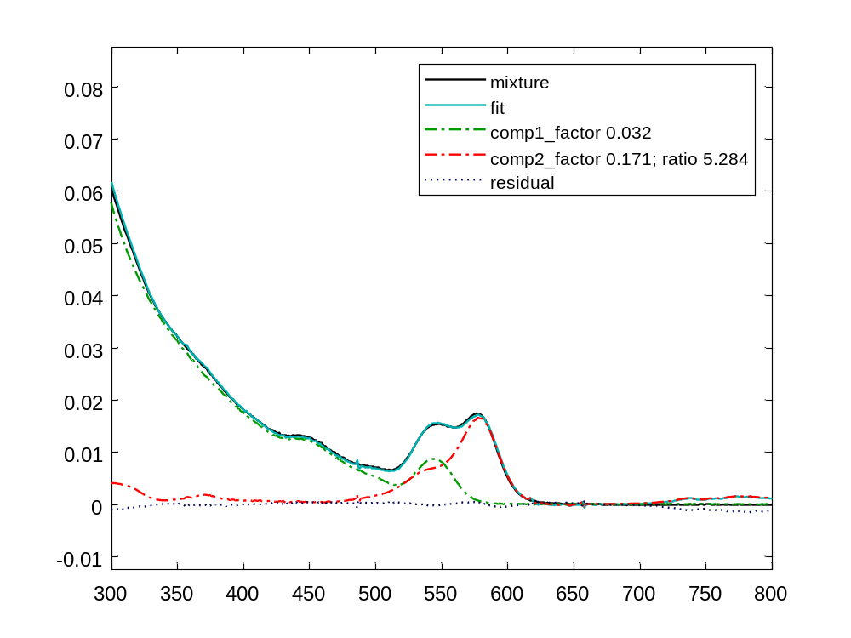
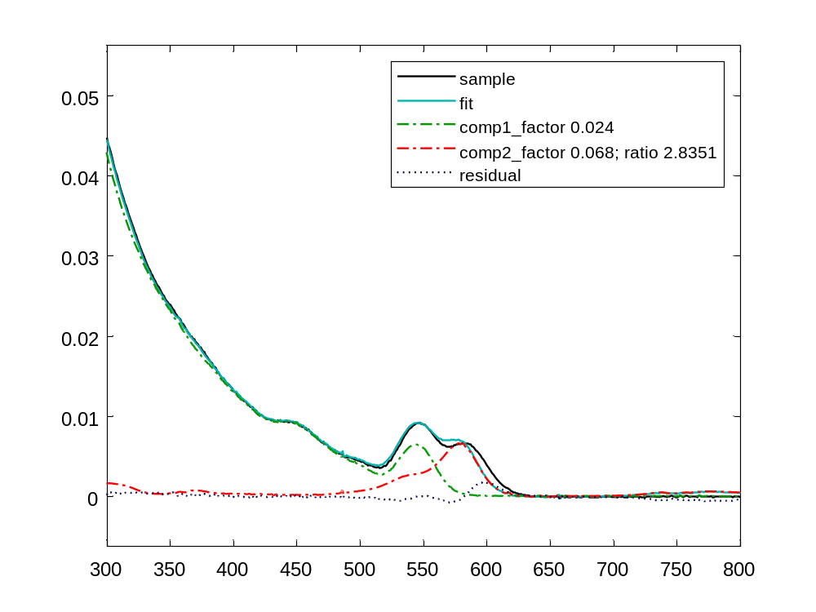
Absorption spectra of combined QD and dye
Absorbance of couple shows red shift of dye contribution vs. free dye spectrum
  Purified dye ratio ~2.8
  Not a perfect fit: shows shift not seen for mixture
Fit mixture of QDs and free, unreactive dye (control, 4-8C) with reference spectra
Fit purified QD-dye conjugate (4-8A) with reference spectra
Sample | Mix ratio | Purified ratio | Efficiency
4-8 A (rox-nhs dye) | 5.0 (not shown) | 2.8 | ~56%
4-8 C (rox free acid) | 5.3

Slide 3
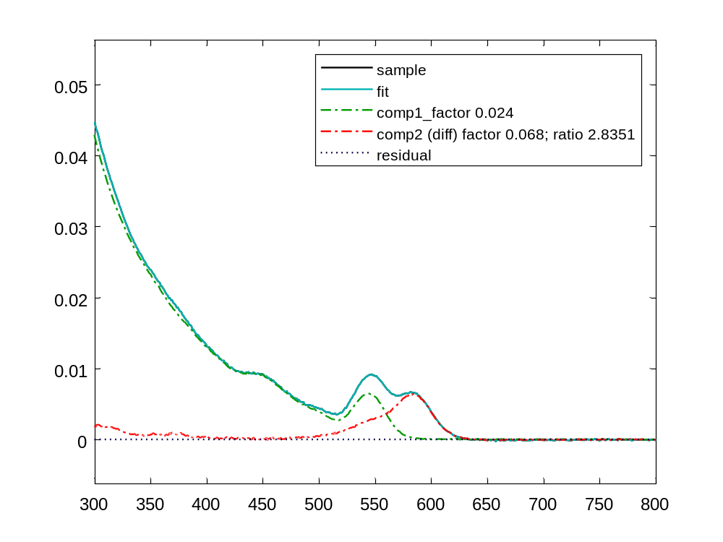
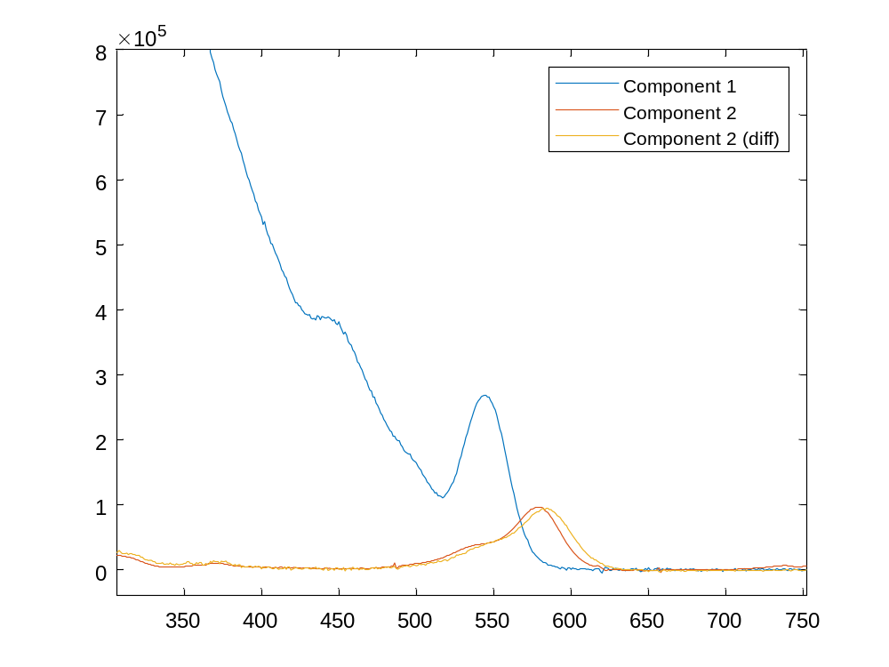
4-8 rox-apeg couple: More absorbance data
Absorbance of couple shows red shift of dye contribution vs. free dye spectrum
  Dye ratio ~2.8
  Shift not seen for mixture
Extinction spectrum of bound dye
(taking estimated ratio to be correct)
Consider difference spectrum
Sample | Mix ratio | Purified ratio | Efficiency
4-8 A (rox-nhs dye) | 5.0 (not shown) | 2.8 | ~56%
4-8 C (rox free acid) | 5.3

